Slide 1


Fitness Center
Presented By : - B.Sc.(IT) Semester-VI
Presented By:
Ashish Soni[19082231054]
Shrey Patel [19082231036]
Guided By : Ms. Dhara Darji
Internal Guide name:- Ms. Dhara Darji
Submitted to Department of Computer Science,
GANPAT UNIVERSITY
April - May 2022

Slide 2
Index:-
Project Profile & Objectives
Requirement specification (Existing System)
Need for the New System
Minimum Hardware & Software Requirement
Function Specification
System Flow Chart
ER Diagram
Data Flow Diagram (DFD)
Data Dictionary
Brief Description Process
Input Design
Output Design
Testing
Future Enhancement
Bibliography

Slide 3
1.Project Profile & Objectives
Project Title:- | Fitness Center (E-Commerce Website)
Objectives:- | Fitness Center is used to give online Selling Equipment, and other products related to fitness.
Developed for:- | Project Submission
Development Tool:- | Sublime Text 3
Front end Tool:- | Html5,Css3,Javascript,Jquery
Back end Tool:- | PHP(8.0),MYSQL(8.0)
Internal guide:- | Ms. Dhara Darji
Prepared by:- | Ashish Soni & Shrey Patel

Slide 4
Existing System
There is no guarantee of good quality equipment in existing system
There is no guarantee of good durability of equipment's in existing system.
There is no guarantee of safe shipping without damaging equipment in existing system
There is no guarantee of good discount on equipment’s in existing system.

Slide 5
2.Requirement specification (Existing System)
Code Editor | Sublime text editor , VS code
Testing | Chrome
Front-end | Html 5 , CSS3 , java ,
Back-end | MYSQL 5.8, PHP 8.0
OS | Windows 10
Other software | Xampp 8.0.10

Slide 6

3.Need for New System
There is a facility to buy online gym equipment's.
User can not buy any product without registration and login.
User can not log in without verification code at first time.
User can also get an offers in festivals.
There will be no false delivery if there it is use can complaint it and resolve in 24 hour.
After order successfully user can get the detail in mail.

Slide 7
4.MINIMUM HARDWARE REQUIREMENT
Server Configuration :-
Processor | : | Corei3 or Higher
RAM | : | 4 GB
Hard disk | : | 1 TB
Client Configuration :-
Processor | : | Corei3 or Higher
RAM | : | 4 GB
Hard disk | : | 1 TB

Slide 8
MINIMUM SOFTWARE REQUIREMENT
Server Configuration :-
Front End | : | Sublime 3 with php server extension.
Back End | : | SQL Server and apache server
Operating System | : | Windows Server 2008 or Higher
Client Configuration :-
Operating System | : | Windows 10,9,8 or Higher
Browser | : | Internet Explorer 8 or later, Mozilla Firefox 28 or later, Google Chorme 34 or later, Opera 18 ,Any Browser.

Slide 9
5.FUNCTION SPECIFICATION
There Are Main Three Users Of This System.
Admin
Manage All The Master Data
View All The Users
Verify The Users
Manage The Products
Manage Admin Dashboard
Manage Transactions
Users
Can See The Products
Can Search The Products
Can Buy Products
Manage Cart
Manage Profile
Make Payment

Slide 10
6.System Flow Chart
System flow diagram is a basically a graphical and sequential representation of the major steps involved in a systematic process.
Elements use in this diagrams is mention below .
 | Start-end point : An oval represents a start or end point. The terminator symbol marks the starting or ending point of the system. It usually contains the word “Start” or “End”.
 | Arrow :A line is a connector that shows relationships between the representative shapes.
 | Process :A rectangle represents a process.
 | Decision : A diamond indicates a decision. It appoints where the outcome of a decision dictates the next step. There can be multiple outcomes, but often there are just two – yes and no or true – false, then branches to different parts of the system flow diagram.
 | Input/output :For taking something input from user like form filling or asking for user credentials this symbol is used

Slide 11
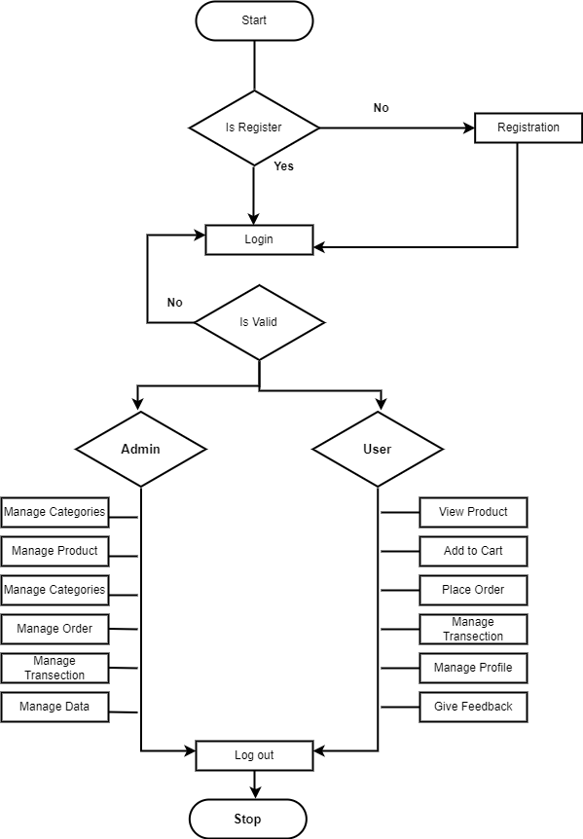
6.System Flow Chart
This diagram show how system works .
The visitor can only able to register.
The user need to login to access full function and if id or password is incorrect then system show an error message .
Same login system works for admin. If id or password is incorrect admin not able to login.

Slide 12
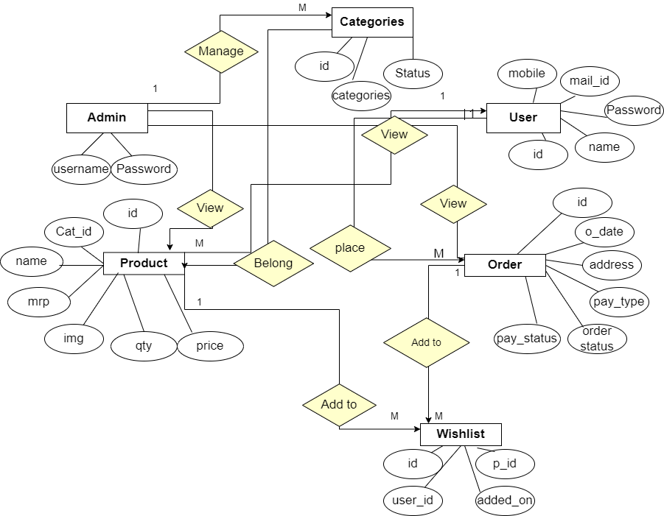
7.ER Diagram

Slide 13
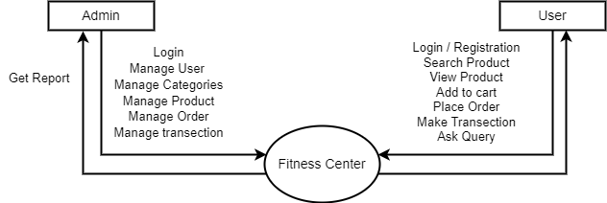
8.Context Level

Slide 14
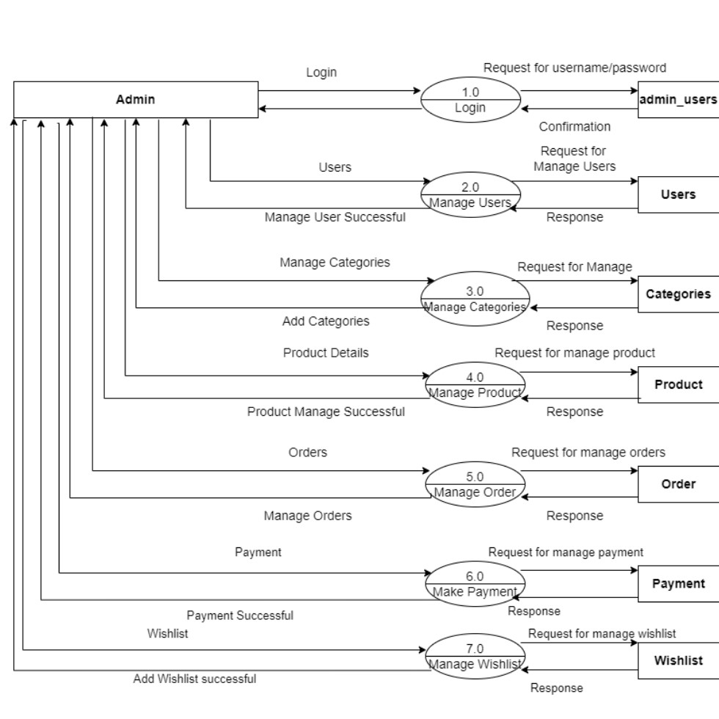
8.Data Flow Diagram
First Level for admin

Slide 15
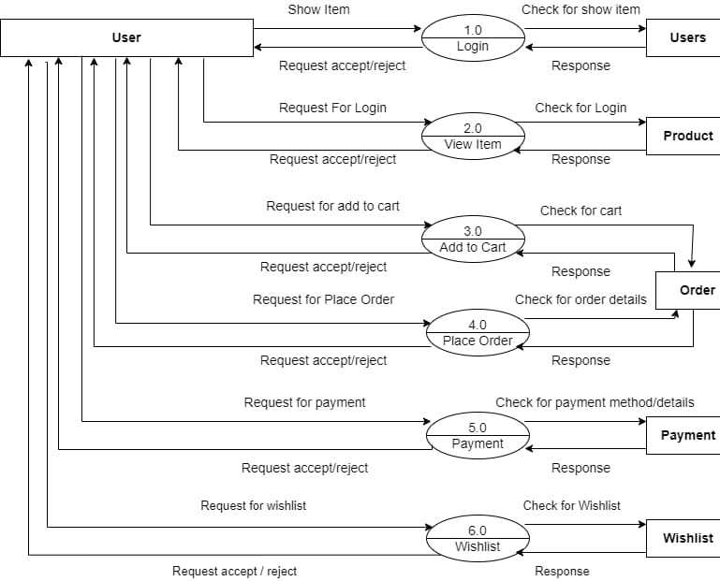
Second Level for User
8.Data Flow Diagram

Slide 16
9.Data Dictionary
Index Of Table
A. Admin Table
B. User Table
C. Categories Table
D. Product table
E. Order table
F. Order details Table
G. Contact us Table
I. Wish list table

Slide 17
9.Data Dictionary
A. Admin Table
Table Name : admin_users
Primary key: id
Fieldname | Data types | Size | Constraint | Description
id | int | 11 | primary key | to store id
username | varchar | 12 | not null | to store username
password | varchar | 8 | not null | to store password

Slide 18
B. User Table
Fieldname | Data types | Size | Constraint | Description
id | int | 11 | primary key | to store id
name | varchar | 255 | not null | to store username
password | varchar | 50 | not null | to store password
email | varchar | 50 | not null | to store email
mobile | varchar | 10 | not null | to store mobile
added_on | datetime |  | not null | user enter date
Table name : users
Primary key : id

Slide 19
C. Categories table
Table name : Categories
Primary key : id
Fieldname | Data types | Size | Constraint | Description
id | int | 11 | primary key | to store categories id
categories | varchar | 255 | not null | to store categories
status | tinyint | 4 | not null | to store categories status

Slide 20
G. Product Table
Fieldname | Type | Size | Constraint | Description
Id | Int | 11 | Primary key | To store id
Categories_id | Int | 11 | Not null | To store categories id
Name | Varchar | 255 | Not null | To store name
Mrp | Float |  | Not null | To store mrp
Price | Float |  | Not null | To store price
Qty | Int | 11 | Not null | To store product qty
Image | Varchar | 255 | Not null | To store product image
Short_desc | Varchar | 2000 | Not null | To store product short desc
Desc | Text |  | Not null | To store product desc
Best seller | Int | 11 | Not null | To store best seller
Meta title | Varchar | 2000 | Not null | To store meta title
Meta desc | Varchar | 2000 | Not null | To store meta desc
Meta keyword | Varhcar | 2000 | Not null | To store meta keyword
Status | tinyint | 4 | Not null | To store product status
Table name : product
Primary key : id

Slide 21
F. Order Table
Fieldname | Type | Size | Constraint | Description
Id | Int | 11 | Primary key | To store id
user_id | Int | 11 | Not null | To store user id
Address | Varchar | 250 | Not null | To store address
City | Varchar | 50 | Not null | To store city
Pin code | Int | 6 | Not null | To store pincode
Payment_type | Varchar | 20 | Not null | To store payment method
Total_price | Float |  | Not null | Total amount
Payment_status | Varchar | 20 | Not null | To store payment status
Order_status | Int | 11 | Not null | To store order status
Txnid | Varchar | 20 | Not null | To store transection id
Mihpayid | Varchar | 20 | Not null | To store pay id
Pay_status | Varchar | 20 | Not null | To store pay status
Added_on | datetime |  | Not null | To store time date when user place order
Table name : order
Primary key : id

Slide 22
E. order detail table
Fieldname | Type | Size | Constraint | Description
id | int | 11 | primary key | to store id
order_id | Int | 11 | not null | to store order id
product_id | Int | 11 | not null | to store product id
qty | int | 10 | not null | to store qty
price | float |  | not null | to store price
Table name : order detail
Primary key : id

Slide 23
D. Contact us Table
Fieldname | Data types | Size | Constraint | Description
id | int | 11 | primary key | to store id
name | varchar | 255 | not null | to store name
email | varchar | 75 | not null | to store email
mobile | varchar | 10 | not null | to store mobile
comment | text |  | not null | to store comment
added_on | datetime |  | not null | to store added_on
Table name : contact_us
Primary key : id

Slide 24
I. wish list Table
Fieldname | Type | Size | Constraint | Description
Id | Int | 11 | Primary key | To store id
User_id | Int | 11 | Not null | To store user id
Product_id | Int | 11 | Not null | To store product id
Added_on | timedate |  | Not null | To store timedate when user add wishlist
Table name : wishlist
Primary key : id

Slide 25
10.Brief Description Process
The Fitness Center is a recreational, and social facility geared towards exercise, sports, and other physical activities.
Fitness Center Modules:-
Admin Module
User Module

Slide 26
10.Brief Description Process
Common process for all modules
Registration Process
Login Process
Search Process
Registration Process:-
In this process admin and user must have to registration on that site if it is registered then it will directly go for authentication checking, until admin don’t approve that, user can’t be login and further task.
Login Process:-
In this process, if user is registered the go for checking valid user. It will enter username , password . It can change the password of created user and also view and edit own profile.
Search Process:-
In this process, user and visitors will be searched based on required like from
Dumbbells , treadmills , benches , plates , powder etc.

Slide 27
10.Brief Description Process
Admin Module Process:-
Register User
Dashboard
Categories
Product
Manage Orders
Manage Users
Contact us
Register User :- Admin can manage the register user like view, update ,delete.
Dashboard :- Admin can see all details like a categories master, product master , order master , user master , contact us.
Categories :- Admin can manage the equipment's categories (add , view , delete , update).

Slide 28
10.Brief Description Process
Product :- Admin can manage the product like add , delete , update , activate & deactivate.
Manage Order :- Admin can view the order details and change the order according to current status.
Manage User:- Admin can view the all user of website.
Contact us:- Admin can view the response from the user and change the status.

Slide 29
User Module Process:-
10.Brief Description Process
Login
Search
View Product
Add to cart
Buy now
Transection
Feedback
Login :- User can not buy any product without log in process.
Search:- User can search the equipment's in the search bar for view the new equipment's.
View Product :- User can view any product without registration.

Slide 30
Add to cart:- User can add the equipment's which she/he want buy and also delete the already added items.
Buy Now:- User can buy any product if he/she want to make order.
Transections :- User can buy any product do the make transection and take rewards.
Feedback:- User can share the experience regarding their ordered product.

Slide 31
11. Input Design

Slide 32
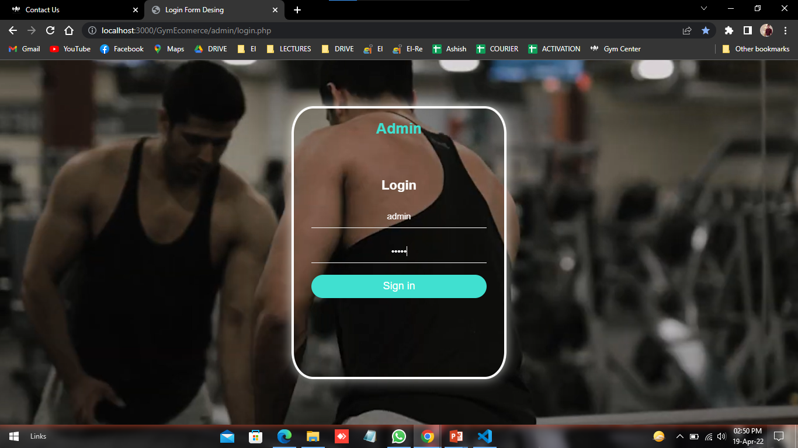
Admin Panel
Admin Login Page:- This is login page for admin

Slide 33
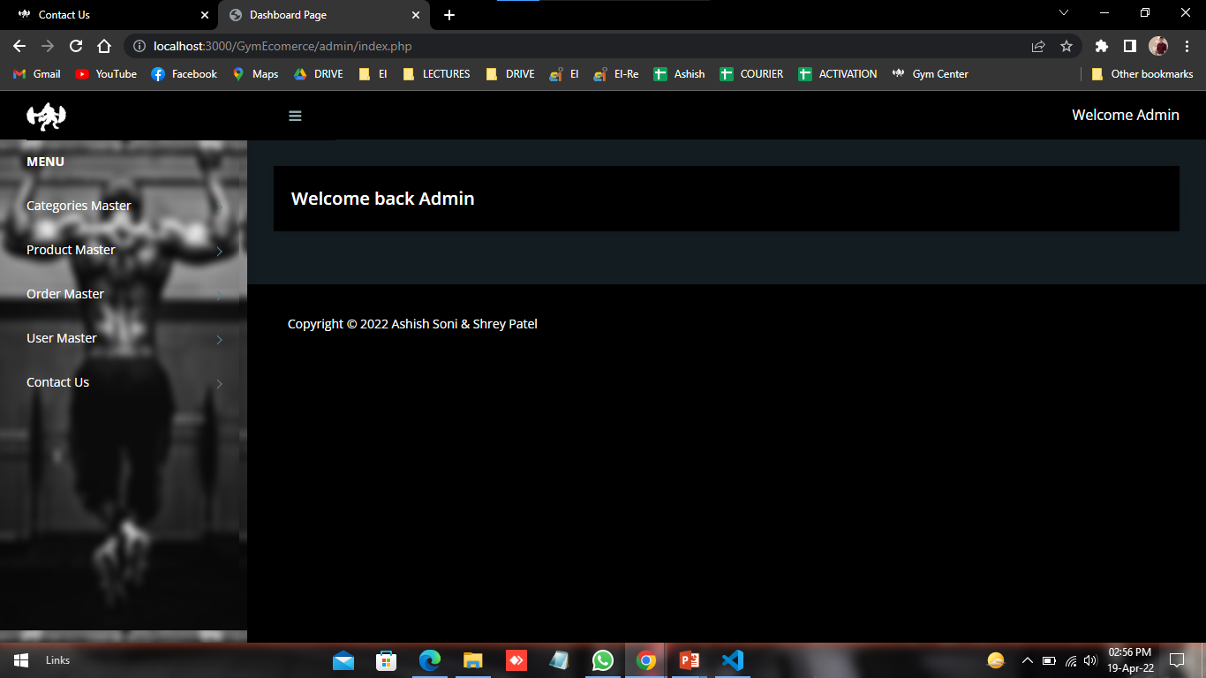
Admin home page:- This is the home page of admin.

Slide 34
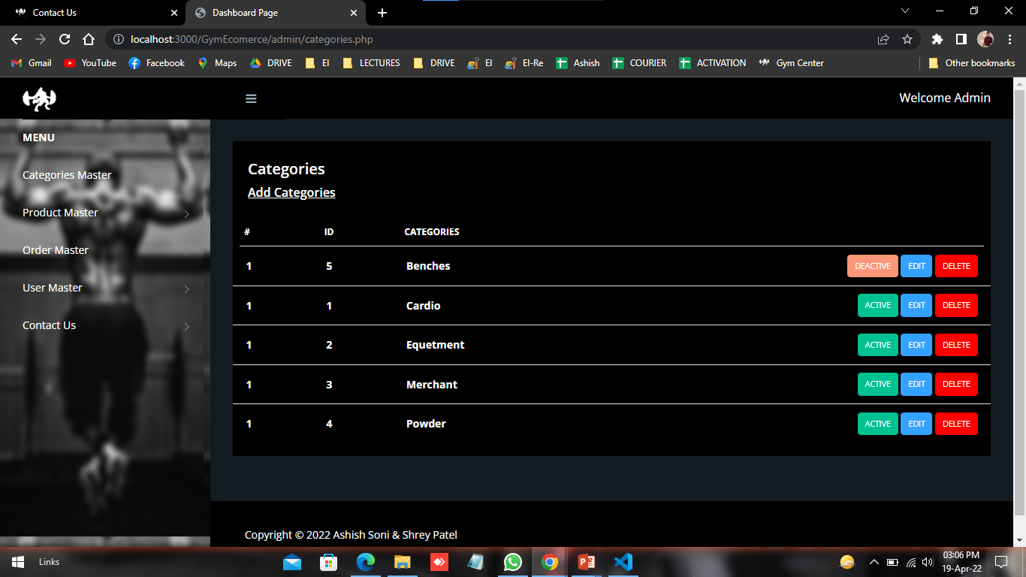
Categories page:- This is Categories page here admin can change the categories master.

Slide 35
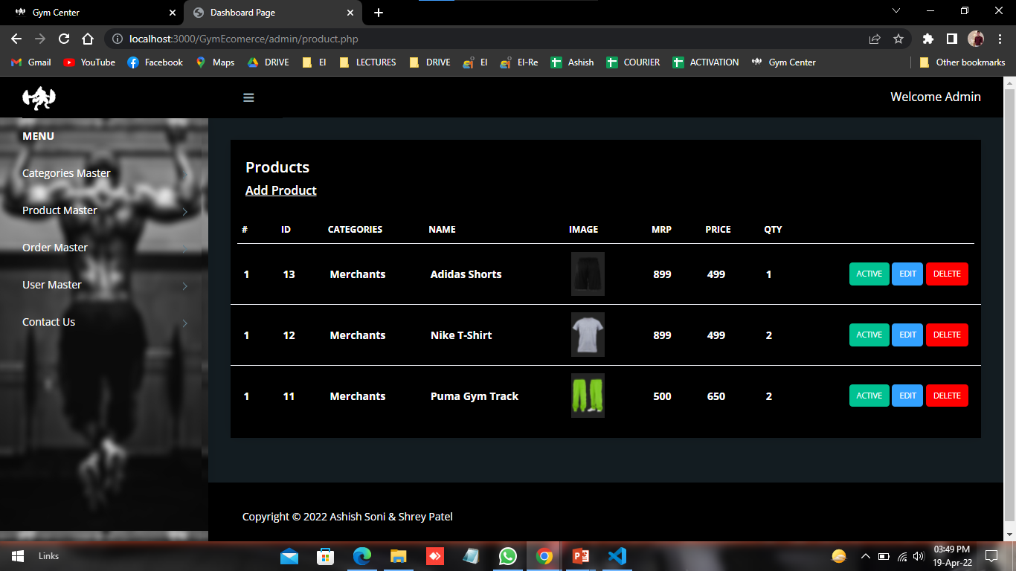
Product Page:- Here admin can view , update , delete , activate , deactivate.

Slide 36
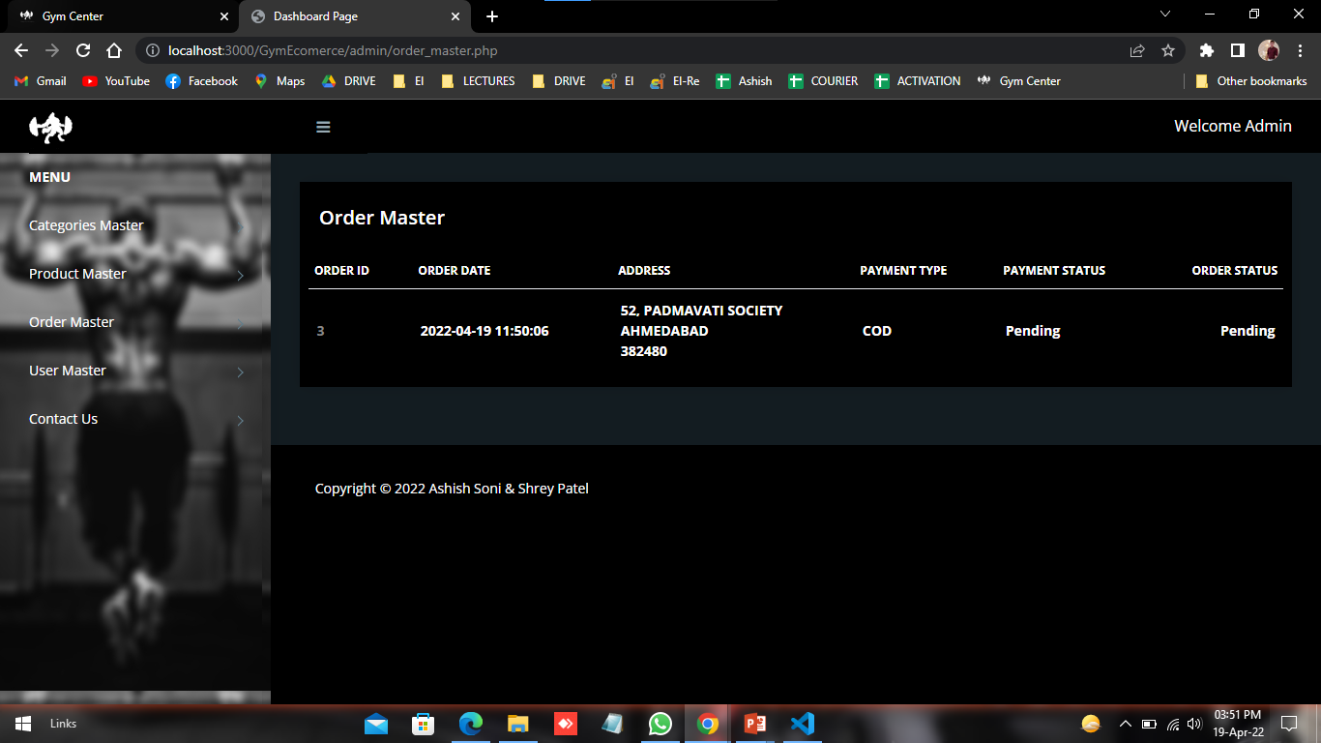
Order Master:- Here Admin can check order master and Manage order & payment status.

Slide 37
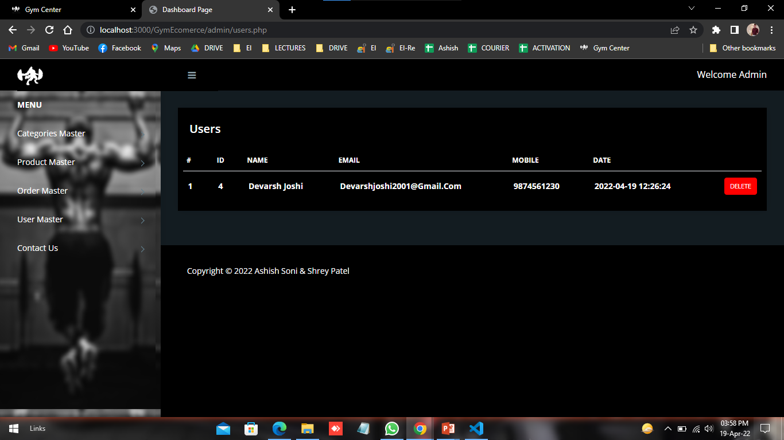
User Master:- Here Admin can show the users.

Slide 38
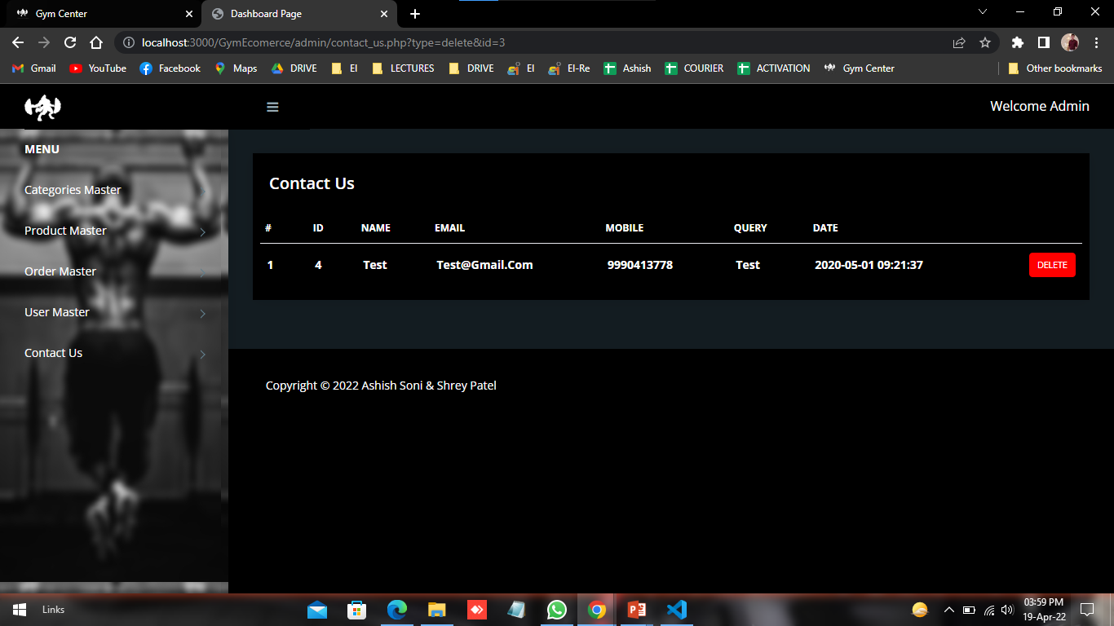
Contact us Master:- Here admin can show the users feedback and suggestion.

Slide 39
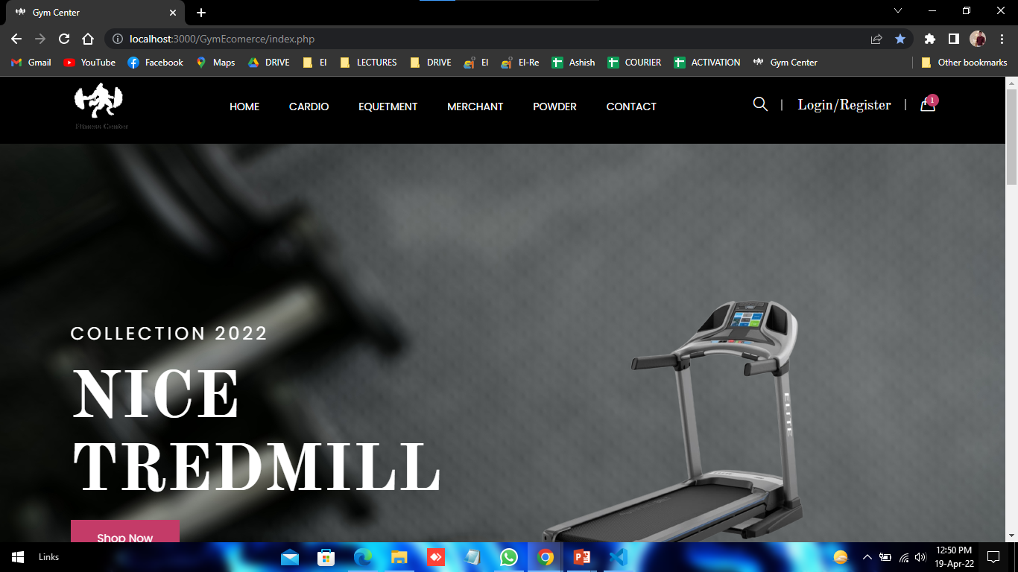
User
Search Page:- This is a search page of user.

Slide 40
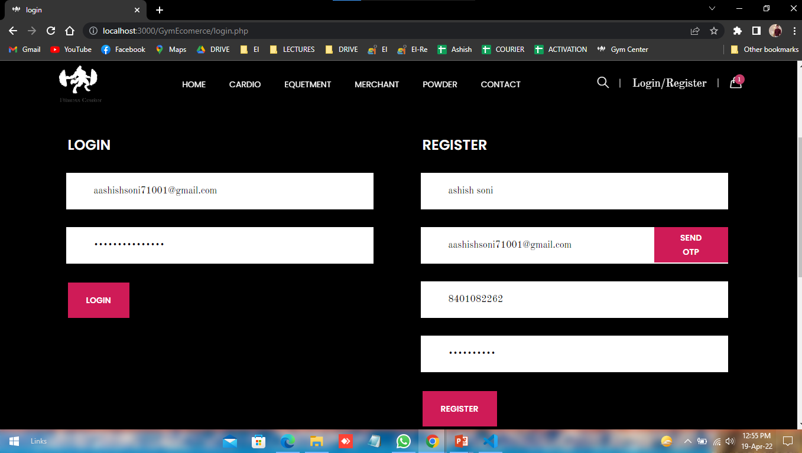
Login page:- This is log in page for customer. Customer can login if she/he want registered.

Slide 41
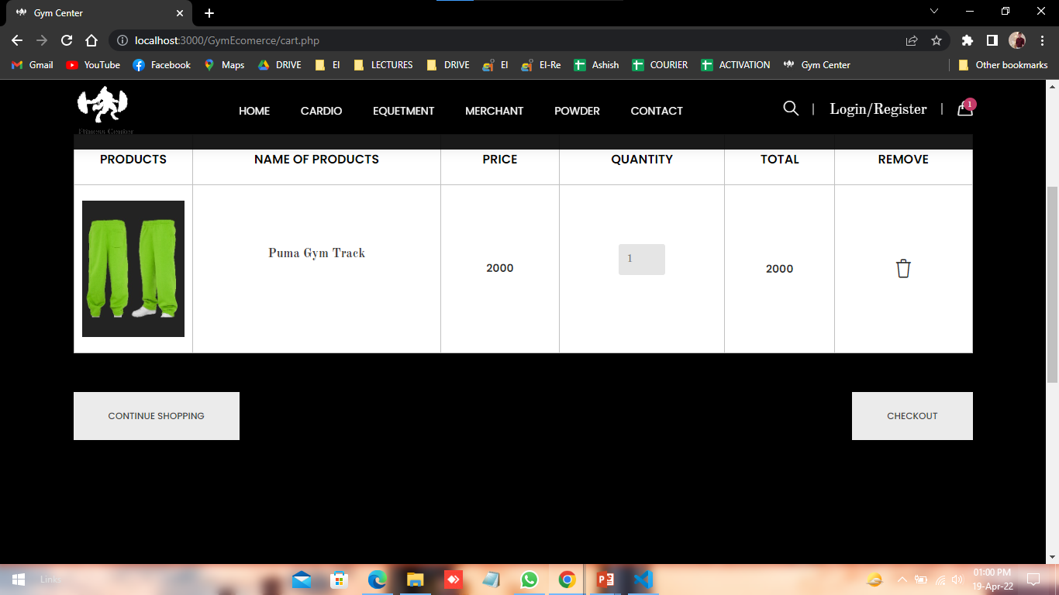
Cart page:- This Is the Cart Page for the customer. Customer can add Equipment's in the cart.

Slide 42
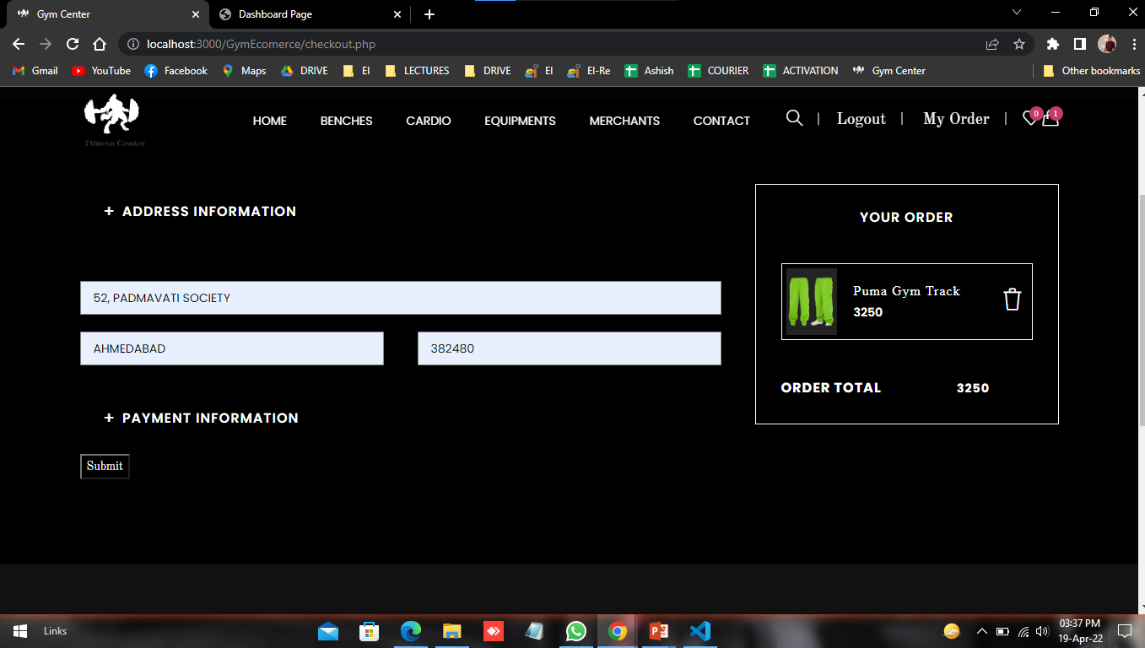
Checkout page:- This is checkout page. User can place order and make payment.

Slide 43
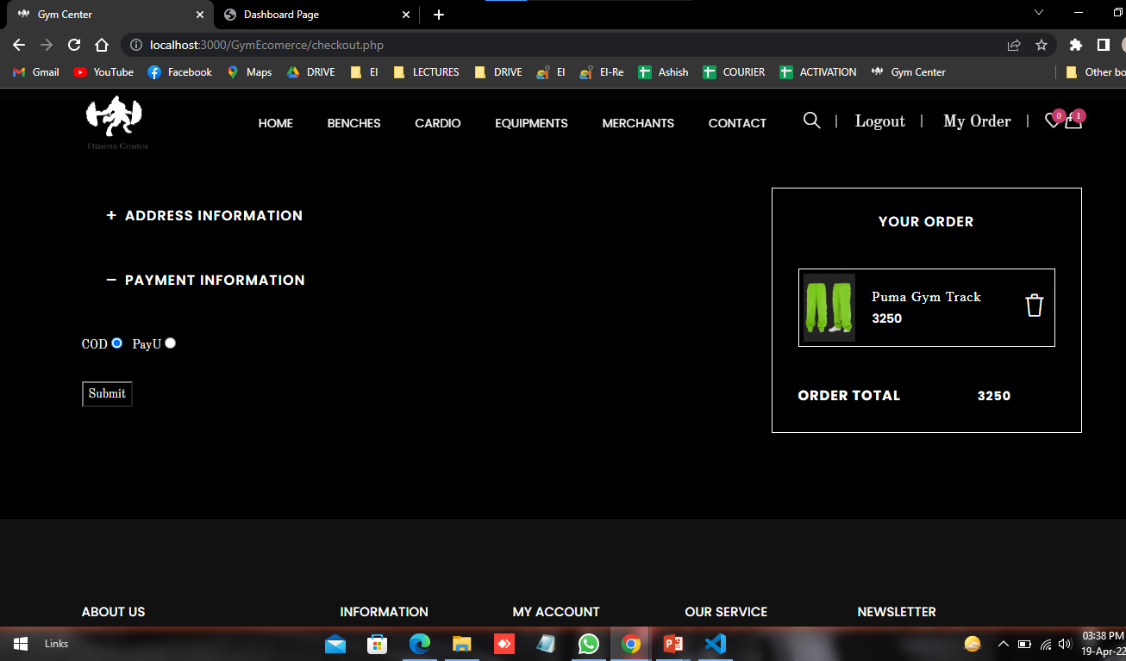
Transection Process:- If user want to pay online or Paytm.

Slide 44
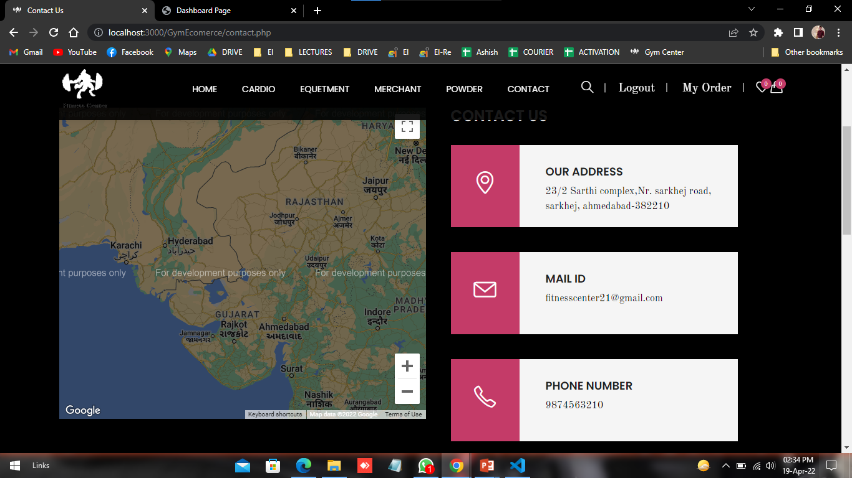
Contact us page:- This is the Contact Us Page of the customer.​ If customer have any doubt he/she can contact us directly.

Slide 45
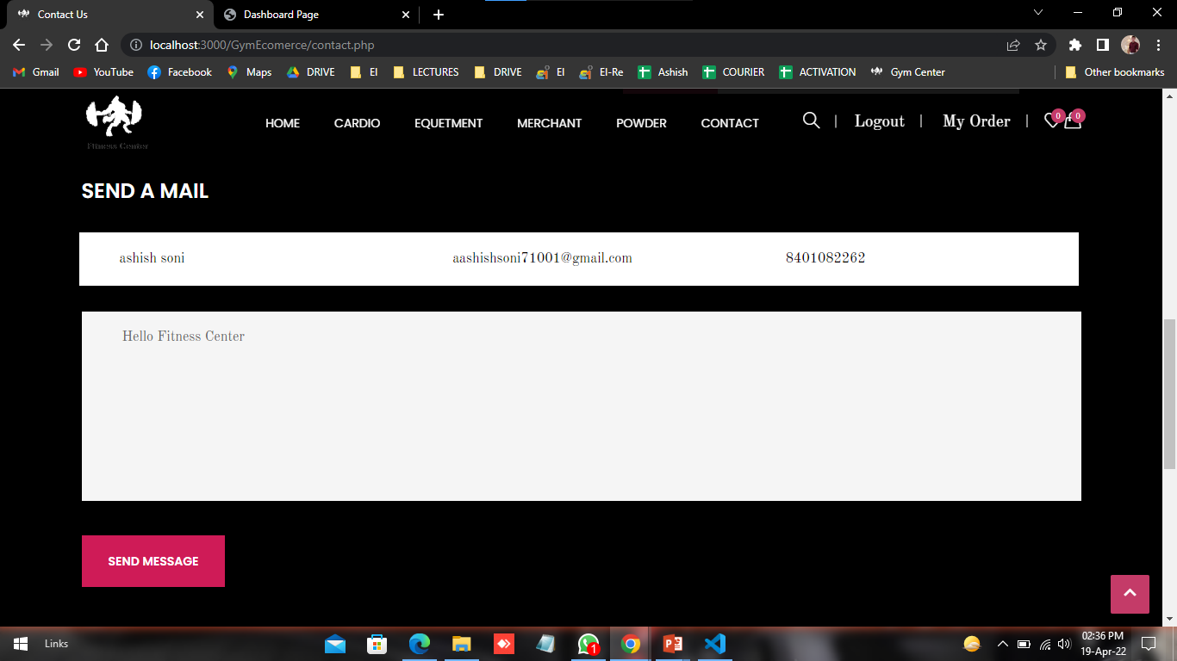
Contact us

Slide 46
12. Output Design

Slide 47
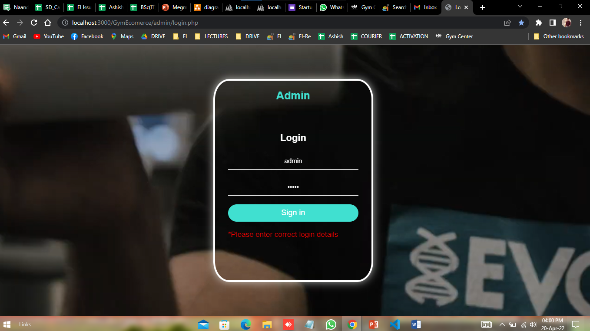
Output

Slide 48
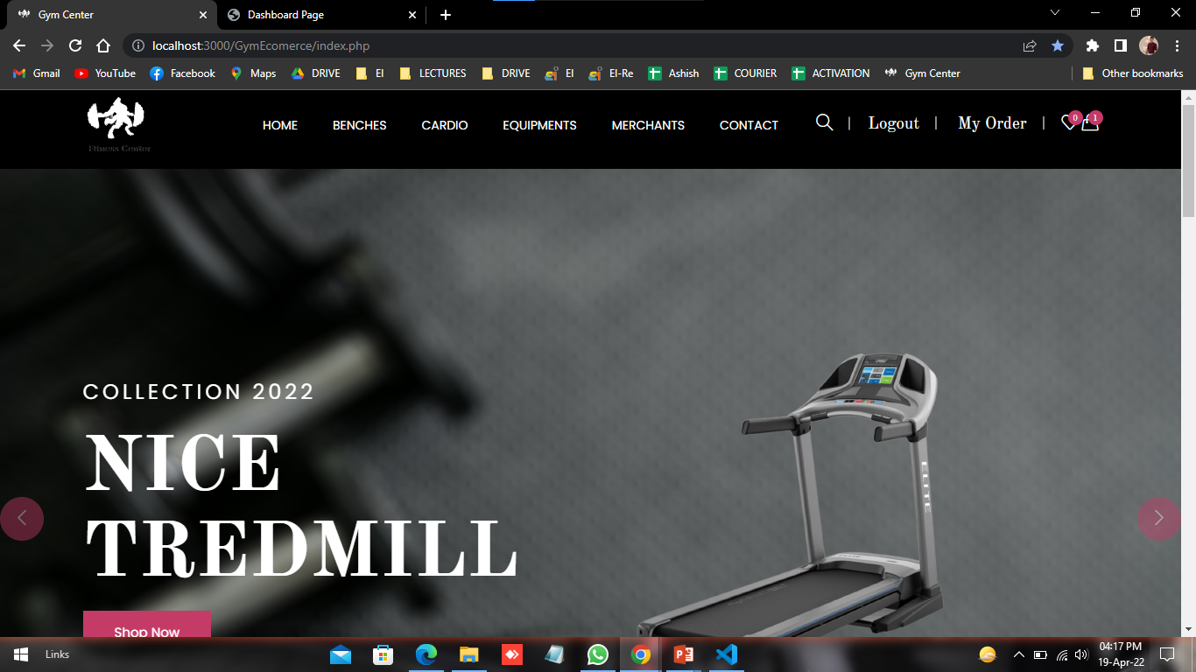
Output index page:- After User login / register , this is the output design.

Slide 49
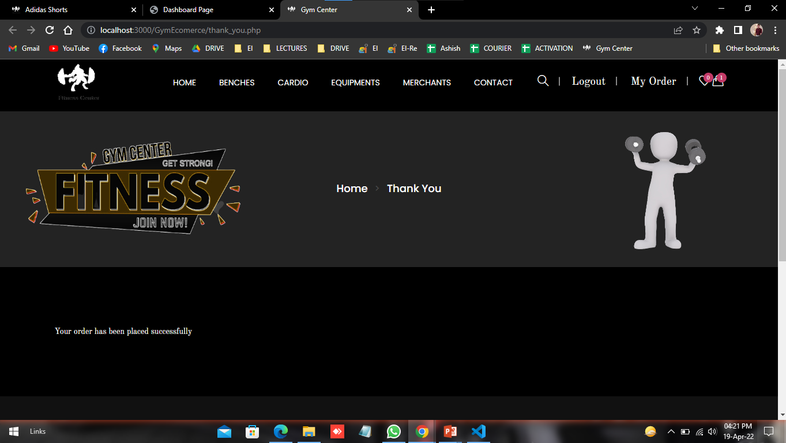
Order:- After complete all checkout method, this is output design.

Slide 50
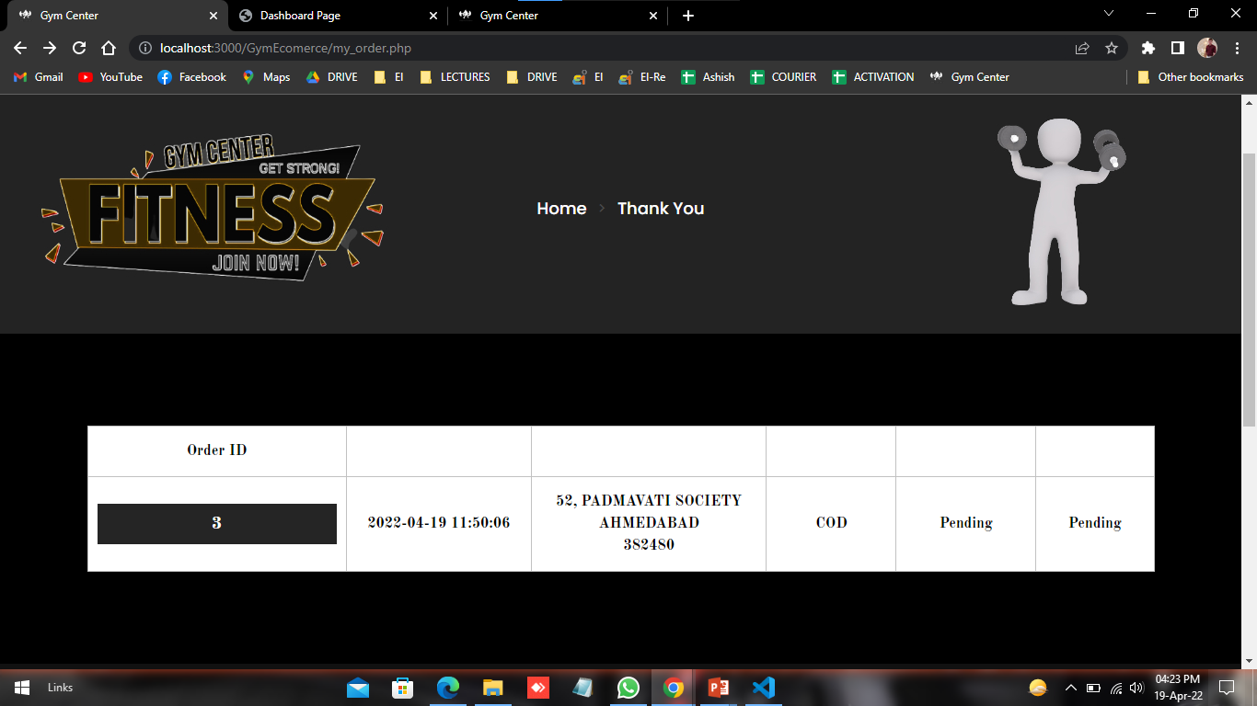
Order Status:- After complete all checkout method, order process then give order id.

Slide 51
13.Testing

Slide 52
Test Case 1
Test Case Id | B002
Purpose | User Registration
Test case created by | Ashish
Test Environment | Google Chrome
Prerequisites | Enter name Email Mobile number password
Test Procedure | Enter name, Email etc.
Test data | Email-id
Expected Result | If Email-id is existing than give error message
Actual Result | Thank you for registration mr. shrey patel
Verdict :Pass/Fail | pass
Comment | Registration For buy any product

Slide 53
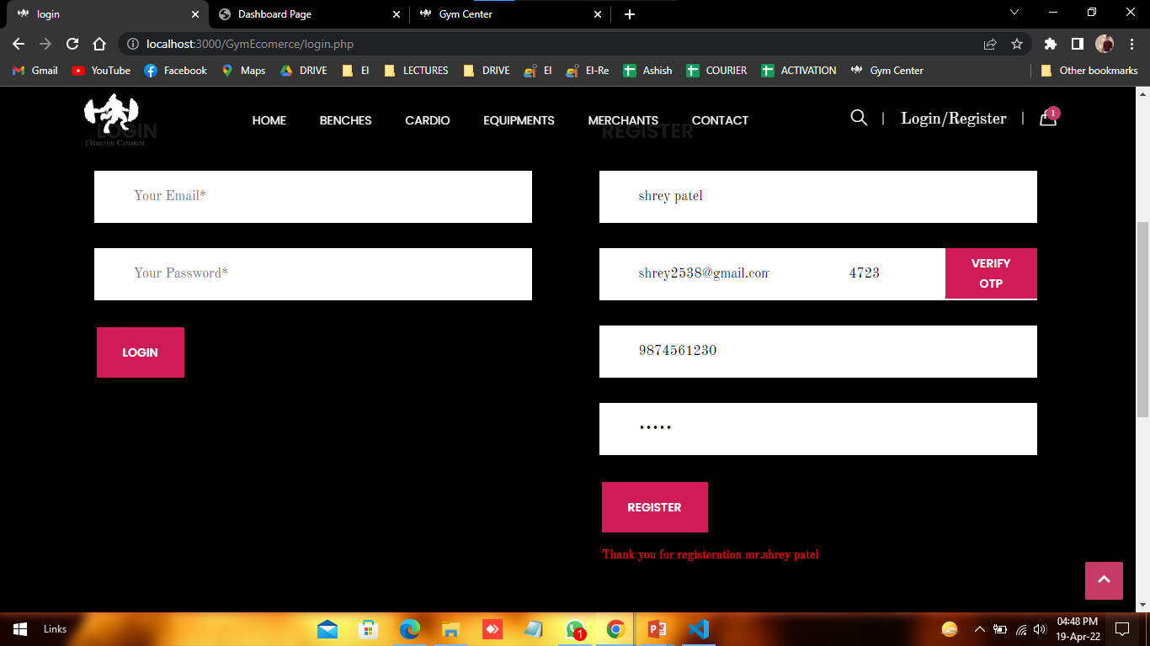
Output

Slide 54
Test Case 2
Test Case Id | B003
Purpose | User Login
Test case created by | Ashish
Test Environment | Google Chrome
Prerequisites | Email Password
Test Procedure | Enter Email , Password
Test data | Email-id
Expected Result | If Password is wrong than give error message
Actual Result | Login Successful
Verdict :Pass/Fail | Fail
Comment | Login to make order, transection , Track Order

Slide 55
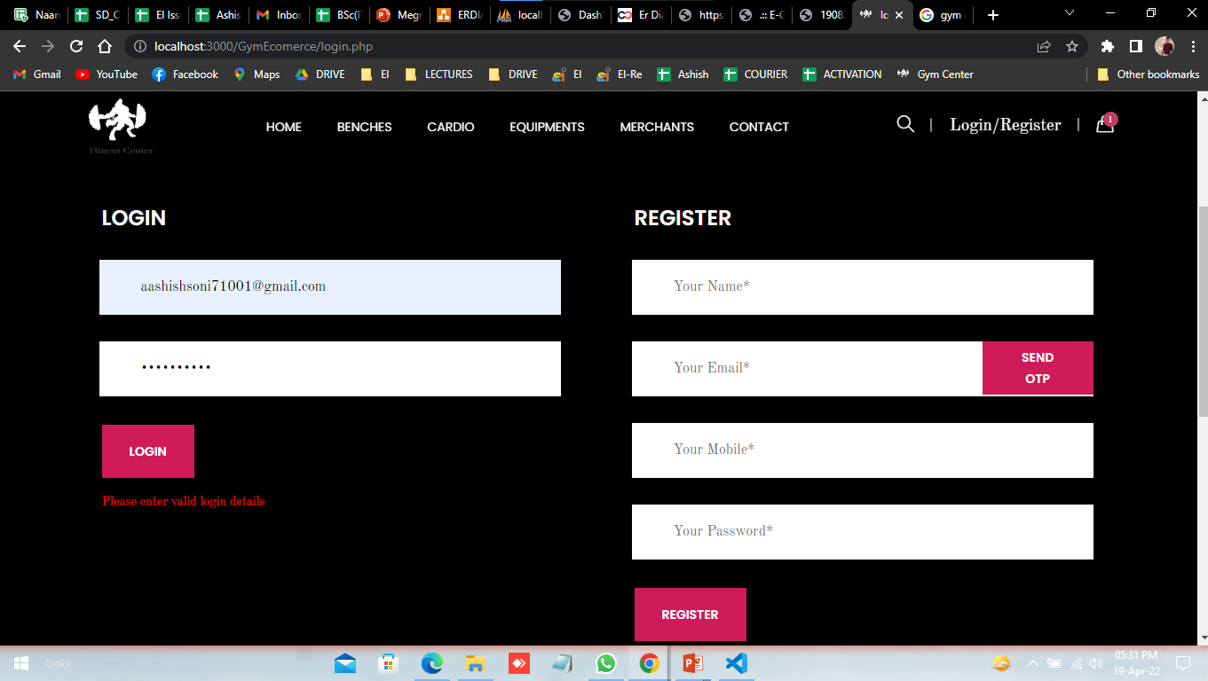
Output

Slide 56
Test Case 3
Test Case Id | B004
Purpose | Admin Login
Test case created by | Ashish
Test Environment | Google Chrome
Prerequisites | username Password
Test Procedure | Enter username , Password
Test data | username
Expected Result | If Username, Password is wrong than give error message
Actual Result | Login Successful
Verdict :Pass/Fail | pass
Comment | Login to make manage order, product etc.

Slide 57
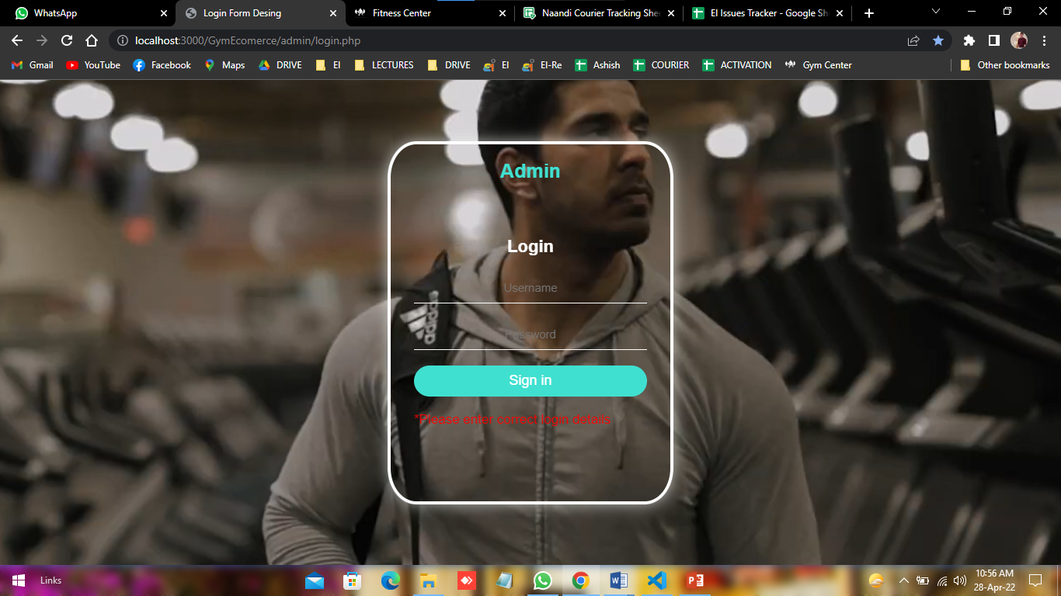
Output

Slide 58
Future Enhancement
Fitness Center project aimed With the help of technology, the fitness industry is absolutely booming. And the thing is – it’s not slowing down anytime soon. Gyms, fitness services, and nutrition manufacturers are all catering to this evolution in interesting and exciting new ways.
Some are the expansion which we have thought of are :-
Add Different payment method such as COD,PAYTM,UPI.
Allow Customer to customize order.

Slide 59
Bibliography​
During the development of our system, we have taken the reference from various sites, which we would like to mention in this section.
No | Book Title | Author | Publisher
1 | Headfirst PHP & MYSQL | Michael Morrison | Hardie Grant Publishing

Slide 60
THANK YOU

